Slide 1
Chapter 8 Sorting

Slide 2
Content Points
Introduction and Notation
Insertion Sort
Selection Sort
Shell Sort
Lower Bounds
Divide-and-Conquer Sorting
Mergesort for Linked Lists
Quicksort for Contiguous Lists
Heaps and Heapsort

Slide 3
Introduction and Notation
（概念和符号）
In an external sort, there are so many records to be sorted that they must be kept in external files on disks, tapes, or the like. In an internal sort the records can all be kept internally in high-speed memory. We consider only internal sorting.（内部排序和外部排序）
We use the notation and classes set up in Chapters 6 and 7.Thus we shall sort lists of records into the order determined by keys associated with the records. The declarations for a list and the names assigned to various types and operations will be the same as in previous chapters.（使用第6、7章中的类，根据记录中的关键字值进行排序。）
Notes:
First we categorize the sort methods into two types,one is external sort and the other is internal sort.

Slide 4

Introduction and Notation
If two or more of the entries in a list have the same key, we must exercise special care. (稳定性)
To analyze sorting algorithms, we consider both the number of comparisons of keys and the number of times entries must be moved inside a list, particularly in a contiguous list. （关键字的比较次数及记录的移动次数）。
Both the worst-case and the average performance of a sorting algorithm are of interest. To find the average, we shall consider what would happen if the algorithm were run on all possible orderings of the list (with n entries, there are n ! such orderings altogether) and take the average of the results.（考虑最坏情况和平均情形下的排序算法性能）。

Slide 5
Sortable Lists
To write efficient sorting programs, we must access the private data members of the lists being sorted. Therefore, we shall add sorting functions as methods of our basic List data structures. The augmented list structure forms a new ADT that we shall call a Sortable_List, with the following form.
  template <class Record>
  class Sortable_list: public List<Record> {
  public: // Add prototypes for sorting methods here.
  private: // Add prototypes for auxiliary functions here.
  };
Hence a Sortable_list is a List with extra sorting methods. The base list class can be any of the List implementations of Chapter 6.

Slide 6
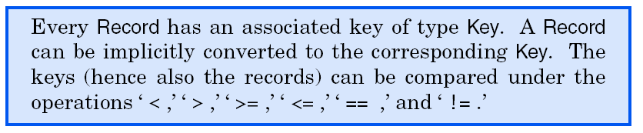
Sortable Lists
We use a template parameter class called Record to stand for entries of the Sortable_list.
Any of the Record implementations discussed in Chapter 7 can be supplied, by a client, as the template parameter of a Sortable_list.(使用与chapter7中同样的record类和key类。)

Slide 7
INSERTION SORT
（插入排序）
Ordered Insertion
  An ordered_list is an abstract data type, defined as a list in which each entry has a key, and such that the keys are in order; that is, if entry i comes before entry j in the list, then the key of entry i is less than or equal to the key of entry j .
Notes:
即为chapter7查找中所提到的ordered_list.
经常要使用retrieve和insert操作。
根据关键字值决定新元素的插入位置。

Slide 8

INSERTION SORT
  For ordered_lists, we shall often use two new operations that have no counterparts for other lists, since they use keys rather than positions to locate the entry.（根据key值定位元素）
    One operation retrieves an entry with a specified key from the ordered list. Retrieval by key from an ordered list is exactly the same as searching.

Slide 9
INSERTION SORT
The second operation, ordered insertion, inserts a new entry into an ordered list by using the key in the new entry to determine where to insert it in the list.
  Note that ordered insertion is not uniquely specified if the list already contains an entry with the same key as the new entry, since the new entry could go into more than one position.(当表中已有关键字相同的记录时，插入的位置是不唯一的。

Slide 10
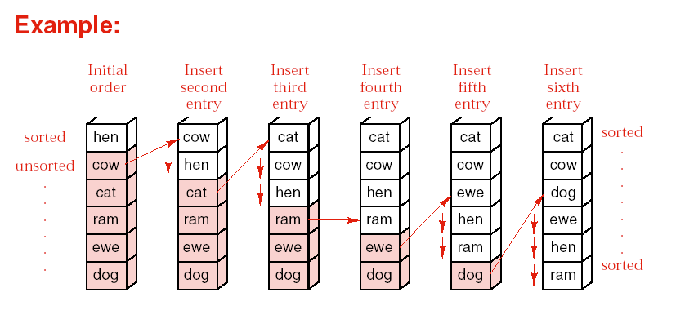
INSERTION SORT
Sorting by Insertion
Notes:
初始情况下，认为0号关键字记录本身是有序的。依次插入表中的剩余元素，保证表中的元素再插入后仍然有序。
we consider the first record form an ordered list which has only one entry.
Then we will insert the following records by executing the ordered-insertion n-1 times.

Slide 11
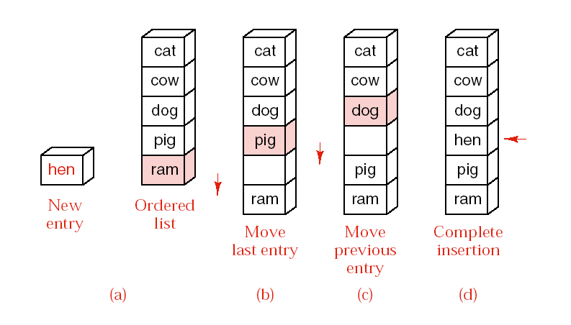
The chart of ordered insertion

Slide 12
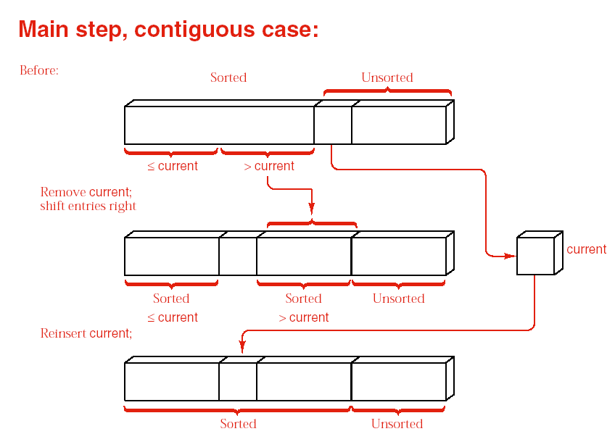
Notes:
The process includes three parts:
The first unsorted_record is Pulled out of the the list into the variable current
Pushes every entry one position down the list until the correct position is found
Reinsert the current record into the list

Slide 13
  template <class Record>
  void Sortable_list<Record> :: insertion_sort( )
  {….
  for (first_unsorted=1;first_unsorted<count;first_unsorted++)
  {current=entry[first_unsorted];
  position=first_unsorted-1;
  while (position>=0 && current<entry[position])
  { entry[position+1]=entry[position];position--;}
  entry[position+1]=current;
  }

Slide 14
INSERTION SORT
  for (first_unsorted = 1; first_unsorted < count; first_unsorted++)
  if (entry[first_unsorted] < entry[first_unsorted - 1]) {
  position = first_unsorted;
  current = entry[first_unsorted]; // Pull unsorted entry out of the list.
  do { // Shift all entries until the proper position is found.
  entry[position] = entry[position - 1];
  position--; //position is empty.
  } while (position > 0 && entry[position - 1] > current);
  entry[position] = current;
  }
  }
是否稳定排序？

Slide 15
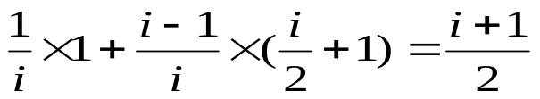
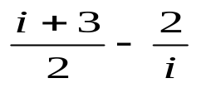
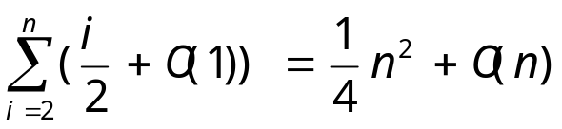
对于插入entry i来说，(元素编号从1开始)
i可以不移动，概率1/i，1次比较，0次移动
也可以移动1，2，…i-1个位置，总的概率(i-1)/i
  Do while 平均次数 (1+2+3….+(i-1))/(i-1)=i/2
  i/2+1次比较，i/2+2次移动
因此，插入entry i所需的平均比较次数为：
次，同理，平均移动次数为：
所以，插入排序平均比较和移动的次数均为：

Slide 16
顺序表下插入排序性能
是稳定排序，在算法设计时保证其稳定性
最好情况发生在表已经有序时，此时时间复杂度为O(n),比较次数为n-1次，移动次数为0次。
最坏情况发生在表反序时，此时时间复杂度为O(n²),比较次数为n(n-1)/2次，移动次数为n(n-1)/2+2(n-1)次。

Slide 17
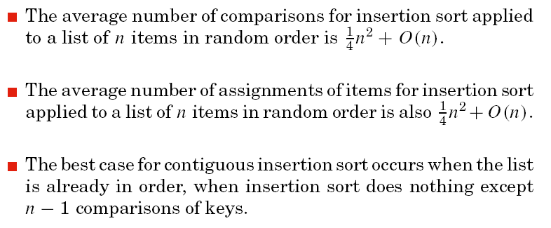
INSERTION SORT
Analysis of contiguous Insertion Sort

Slide 18

INSERTION SORT
Analysis of Insertion Sort
  The worst case for contiguous insertion sort occurs when the list is in reverse order.
  Insertion sort verifies that a list is correctly sorted as quickly
  as any method can.(插入排序对已正确排序的表排序最快。)

Slide 19
INSERTION SORT
Key point of Linked Insertion Sort
  With no movement of data, there is no need to search from the end of the sorted sublist, as for the contiguous case. （不需移动元素,不从……）
  Traverse the original list, taking one entry at a time and inserting it in the proper position in the sorted list.（每次在已经有序的链表下插入一个新元素）
  Pointer last_sorted references the end of the sorted part of the list.
  Pointer first_unsorted == last_ sorted->next references the first entry that has not yet been inserted into the sorted sublist.

Slide 20
INSERTION SORT
Key point of Linked Insertion Sort
  Pointer current searches the sorted part of the list to find where to insert *first_unsorted.
  If *first_ unsorted belongs before the head of the list, then insert it there.
  Otherwise, move current down the list until
  first_unsorted->entry <= current->entry
  and then insert *first_unsorted before *current. To enable insertion before *current, keep a second pointer trailing in lock step one position closer to the head than current.

Slide 21
INSERTION SORT
Key point of Linked Insertion Sort
  A sentinel(哨兵) is an extra entry added to one end of a list to ensure that a loop will terminate without having to include a separate check. Since last_sorted->next == first_unsorted, the node *first_unsorted is already in position to serve as a sentinel for the search, and the loop moving current is simplified.
  A list with 0 or 1 entry is already sorted, so by checking these cases separately we avoid trivialities else where.

Slide 22
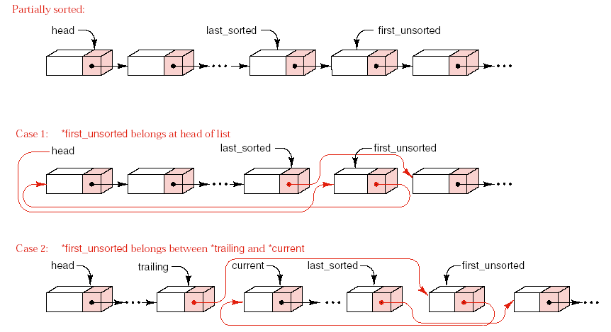

Slide 23
INSERTION SORT
Linked Insertion Sort
  template <class Record>
  void Sortable_ list<Record> :: insertion_sort( )
  /* Post: The entries of the Sortable_ list have been rearranged so that the keys in all the entries are sorted into non_decreasing order.
  Uses: Methods for the class Record , linked List implementation of Chapter 6. */
  { Node <Record> *first_unsorted, // the first_ unsorted node to be inserted
        *last_sorted, // tail of the sorted sublist
        *current, // used to traverse the sorted sublist
        *trailing; // one position behind current
  if (head != NULL) { // Otherwise, the empty list is already sorted.
    Last_sorted = head; // The first node alone makes a sorted sublist.
    while (last_ sorted->next != NULL) {
    first_unsorted = last_sorted->next;

Slide 24
INSERTION SORT
  if (first_unsorted->entry < head->entry) {
    // Insert*first_unsorted at the head of the sorted list
    Last_sorted->next = first_unsorted->next;
    first_unsorted- >next = head;head = first_unsorted; }
  else { // Search the sorted sublist to insert *first_unsorted
  trailing = head;
  current = trailing->next;
  while (first_unsorted->entry > current->entry) {
  trailing = current;
  current = trailing->next;
  }
  // *first_unsorted now belongs between*trailing and*current .
  if (first_unsorted == current)
  last_sorted = first_ unsorted; //already in right position
  else { last_sorted->next =first_unsorted->next;
  first_unsorted->next = current;
  trailing->next = first_unsorted;} } } } }

Slide 25
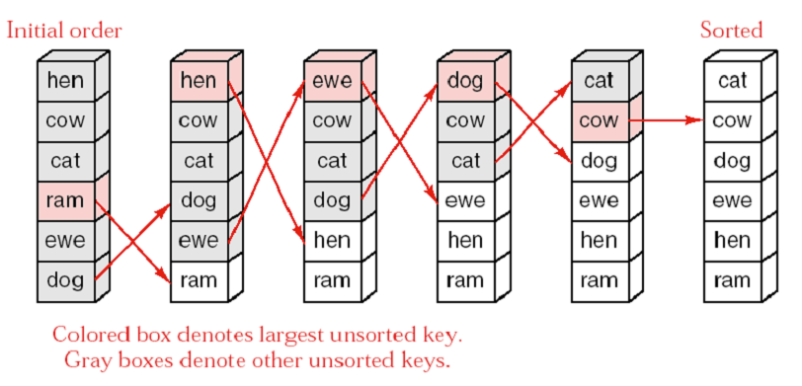
SELECTION SORT（选择排序）
Notes:
目的是减少移动次数。
主要对表元素比较大的顺序表有用。

Slide 26
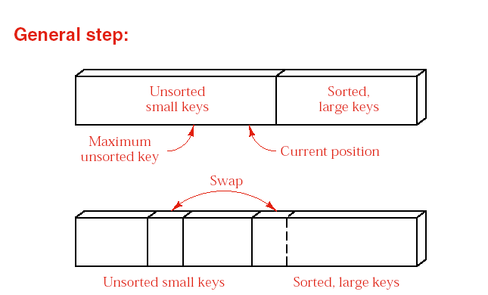
SELECTION SORT

Slide 27
SELECTION SORT
template <class Record>
void Sortable_list<Record> :: selection_sort( )
/* Post: The entries of the Sortable_list have been rearranged so that the keys in all the entries are sorted into non_decreasing order.
Uses: max_key ,swap . */
{
  for (int position = count - 1; position > 0; position--) {
    int max = max_ key(0, position);
    //if (max!=position)
    swap(max, position);
}
}

Slide 28
SELECTION SORT
Find maximum key:
template <class Record>
int Sortable_list<Record> :: max_key(int low, int high)
/* Pre: low and high are valid positions in the Sortable_list and low <= high .
Post: The position of the entry between low and high with the largest key is returned.
Uses: The class Record . The contiguous List implementation of Chapter 6.*/
{
int largest, current;
largest = low;
for (current = low +1; current <= high; current++)
  if (entry[largest] < entry[current])
  largest = current;
  return largest;
}

Slide 29
SELECTION SORT
Swap entries
  template <class Record>
  void Sortable_list<Record> :: swap(int low, int high)
  /* Pre: low and high are valid positions in the Sortable_list .
  Post: The entry at position low is swapped with the entry at position high .
  Uses: The contiguous List implementation of Chapter 6. */
  {
  Record temp;
  temp = entry[low];
  entry[low] = entry[high];
  entry[high] = temp;
  }

Slide 30
SELECTION SORT
Analysis and comparison
The function swap is call n-1 times, and each call does 3 assignments of entries, for a total count of 3(n-1) assignments.
The function max_key is called n-1 times, with the length of the sublist ranging from n down to 2. Hence, altogether, there are (n-1)+(n-2)+…+1=n(n-1)/2 comparisons of keys.

Slide 31
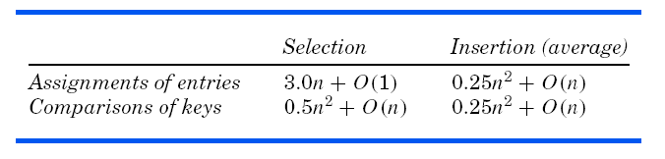
SELECTION SORT
Analysis and comparison
选择排序的效率与初始状态无关。插入排序的效率与初始状态有关，最好情况是当原始数据基本有序时(n-1次比较，0次移动）。
由于减少了移动次数，当记录元素较大时，选择排序比插入排序更为合适。而记录元素较小，移动花费时间不多时，插入排序由于比较次数少，会更好。
选择排序适用于顺序结构。

Slide 32
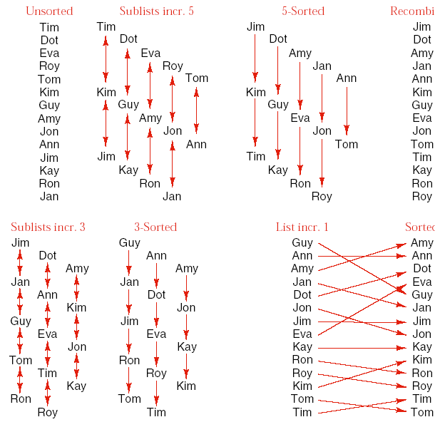
SHELL SORT
（希尔排序）
Example
Notes:
Selection sort moves the entries very efficiently but does many redundant comparisons.
In its best case, insertion sort does the minimum number of comparisons, but it is inefficient in moving entries only one position at a time.
Object: avoid both the above problems.

Slide 33
SHELL SORT
template <class Record>
void Sortable list<Record> :: shell_sort( )
/* Post: The entries of the Sortable_ list have been rearranged so that the keys in all the entries are sorted into nondecreasing order.
Uses: sort_interval */
{
int increment, //spacing of entries in sublist
start; //starting point of sublist
increment = count;
do {
    increment = increment/3 + 1;
    for (start = 0; start < increment; start++)
    Sort_interval(start, increment); // modified insertion sort
  } while (increment > 1);
}

Slide 34
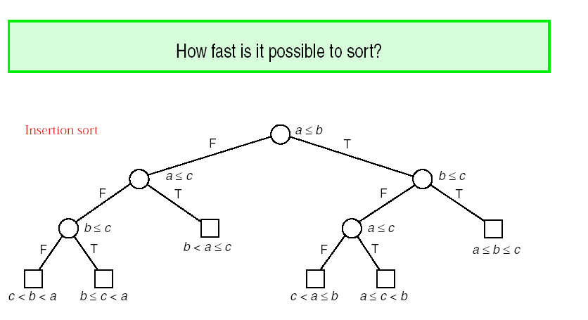
LOWER BOUNDS
Insertion sort
Notes:
Limit our attention to sorting methods that rely entirely on comparisons between pairs of keys to do the sorting.

Slide 35
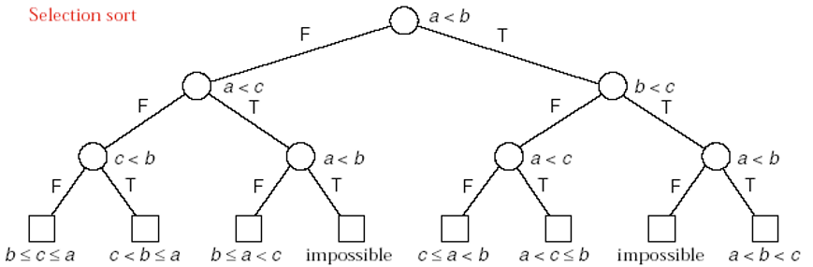
LOWER BOUNDS
Selection sort
The height of the comparison tree is the largest number of comparison that will be made and hence gives the worst-case behavior of the algorithm.
The external path length, after division by the number of leaves, gives the average number of comparisons that the algorithm will do.
从图中可看出，平均情况下，选择排序的比较次数比插入排序多。

Slide 36

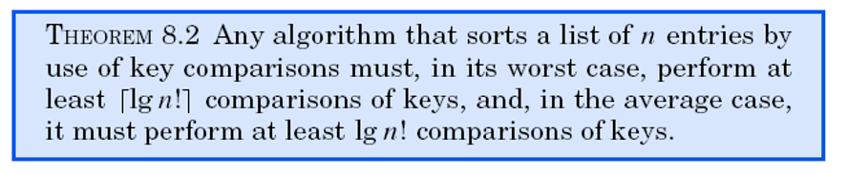
LOWER BOUNDS
The number of ways that the list containing n entries could originally have been ordered is n!, and thus the number of leaves in the tree must be at least n!.
The height of the tree is at least , and its external path length is at least n! lgn!.

Slide 37

LOWER BOUNDS
树的高度体现了最坏情况下的比较次数
平均查找次数=树的外部路径长度/叶结点数
叶结点数至少为n！
根据lemma 7.5,Theorem 7.6 the height of the tree is at least ,外部路径长度至少n!
最坏情况，
平均情况：lgn!
lgn! ≈ nlgn
以关键字比较为基础的排序，关键字的比较次数的数量级起码为O(nlgn)

Slide 38
DIVIDE-AND-CONQUER SORTING
（分而治之的排序）
The Main Ideas
  dividing a problem into smaller but similar subproblems; that is, of divide and conquer.
Outline
    void Sortable_list :: sort( )
    {
    if the list has length greater than 1 {
      partition the list into lowlist, highlist;
      lowlist.sort( );
      highlist.sort( );
      combine(lowlist, highlist);
    }
    }

Slide 39
DIVIDE-AND-CONQUER SORTING
Mergesort（归并排序）
We chop the list into two sublists of size as nearly equal as possible and then sort them separately. Afterward, we carefully merge the two sorted sublists into a single sorted list.(将表分成等长的两个，分别进行排序，然后再合并。

Slide 40
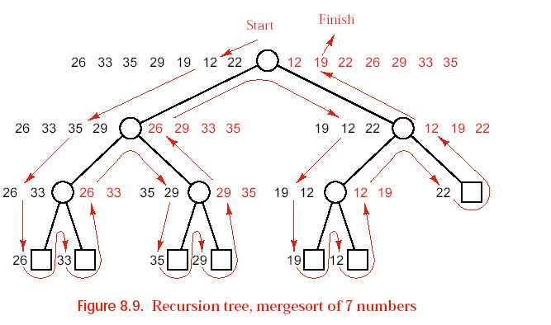
DIVIDE-AND-CONQUER SORTING
Mergesort（归并排序）

Slide 41
DIVIDE-AND-CONQUER SORTING
Quicksort（快速排序）
  We first choose some key from the list for which, we hope about half the keys will come before and half after. Call this key the pivot.（枢轴）
  Then we partition the items so that all those with keys less than the pivot come in one sublist, and all those with greater keys come in another. (比枢轴小的关键字记录在一个子表中，比枢轴大的在另一个子表中)
  Then we sort the two reduced lists separately, put the sublists together, and the whole list will be in order.

Slide 42
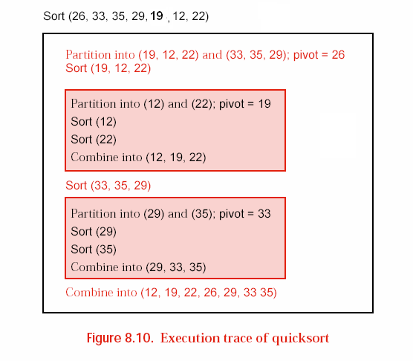
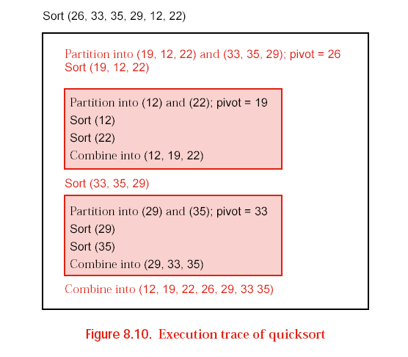
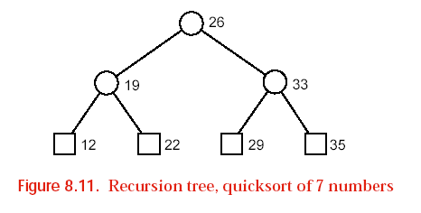
DIVIDE-AND-CONQUER SORTING
Quicksort（快速排序）

Slide 43
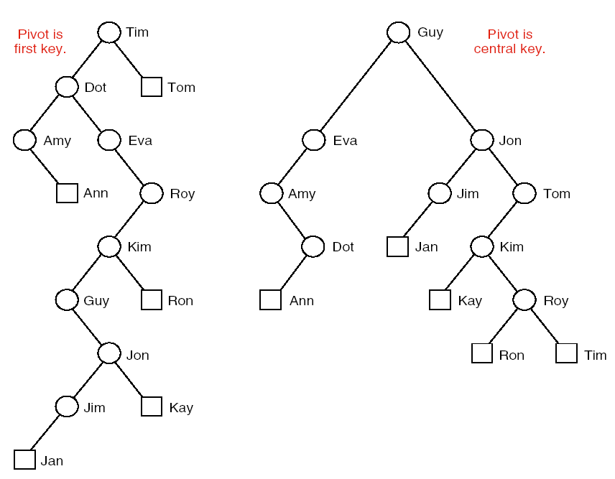
DIVIDE-AND-CONQUER SORTING
Quicksort（快速排序）
Tim Dot Eva Roy Tom Kim Guy Amy Jon Ann Jim Kay Ron Jan

Slide 44
Mergesort for Linked Lists
（链表的归并排序）
Interface method
  template <class Record>
  void Sortable_list<Record> :: merge_sort( )
  /* Post: The entries of the sortable_list have been rearranged so that their keys are sorted into non_decreasing order.
  Uses: Linked List implementation of Chapter 6 and recursive merge sort .
  */
  {
  recursive_merge_sort(head);
  }

Slide 45
Mergesort for Linked Lists
Recursive function
  template <class Record>
  void Sortable_list<Record> ::recursive_ merge_sort(Node<Record> * &sub_list)
  /* Post: The nodes referenced by sub_list have been rearranged so that their keys are sorted into nondecreasing order. The pointer parameter sub_ list is reset to point at the node containing the smallest key.
  Uses: The linked List implementation of Chapter 6; the functions divide_ from ,merge , and recursive_merge_sort . */
  {
    if (sub_list != NULL && sub_list->next != NULL) {//more than one
    Node<Record> *second_half = divide_from(sub_list);
    recursive_merge_sort(sub_ list);
    recursive_merge_sort(second_half);
    sub_list = merge(sub_list, second_half);
  }
  }

Slide 46
Mergesort for Linked Lists
Divide Linked List in Half
  template <class Record>
  Node<Record> *Sortable_list<Record> ::
  divide_from(Node<Record> *sub list)
  /* Post: The list of nodes referenced by sub_list has been reduced to its first half, and a pointer to the first node in the second half of the sublist is returned. If the sublist has an odd number of entries, then its first half will be one entry larger than its second.
  Uses: The linkedList implementation of Chapter 6. */
  {
  Node<Record> *position, // traverses the entire list
  *midpoint, // moves at half speed of position to midpoint
  *second_ half;

Slide 47
Mergesort for Linked Lists
Divide Linked List in Half
  if ((midpoint = sub_list) == NULL) return NULL; // List is empty.
  position = midpoint->next;
  while (position != NULL) { // Move position twice for midpoint 's one move.
  position = position->next;
  if (position != NULL) {
  midpoint = midpoint->next;
  position = position->next;
  }
  }
  second_ half = midpoint->next;
  midpoint->next = NULL;
  return second_half;
  }

Slide 48
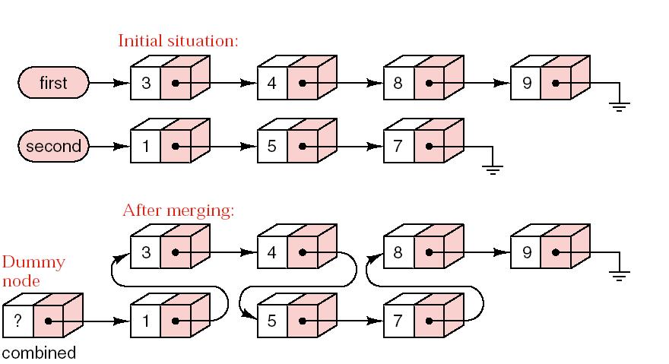
Mergesort for Linked Lists
    last_sorted->next = second;
    last_ sorted = second;
    second = second->next;
Merging two sorted linked lists

Slide 49
Mergesort for Linked Lists
Merge Function
  template <class Record>
  Node<Record> *Sortable_list<Record> ::
  merge(Node<Record> *first, Node<Record> *second)
  /* Pre: first and second point to ordered lists of nodes.
  Post: A pointer to an ordered list of nodes is returned. The ordered list contains all entries that were referenced by first and second . The original lists of nodes referenced by first and second are no longer available.
  Uses: Methods for Record class; the linked List implementation of Chapter 6. */
  {
  Node<Record> *last_sorted; // points to the last node of sorted list
  Node<Record> combined;
  // dummy first node, points to merged list
  Last_sorted = &combined;

Slide 50
Mergesort for Linked Lists
Merge Function
  while (first != NULL && second != NULL) {
  // Attach node with smaller key
  if (first->entry <= second->entry) {
  last_sorted->next = first;
  last_sorted = first;
  first = first->next; // Advance to the next unmerged node.
  }
  else {
    last_sorted->next = second;
    last_ sorted = second;
    second = second->next;
  } }// After one list ends, attach the remainder of the other.
  if (first == NULL)
    last_sorted->next = second;
  else
    last_sorted->next = first;
  return combined.next;
  }

Slide 51
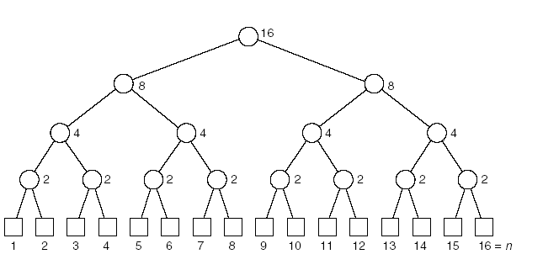
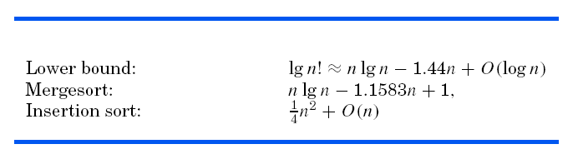
Mergesort for Linked Lists
Analysis of Mergesort
没有移动，
比较发生在merge函数中
最多比较次数不超过两表的长度。
每一层上表的总长为n
因此每一层上关键字的比较次数最多为n
共有层数约lgn
比较共约nlgn

Slide 52
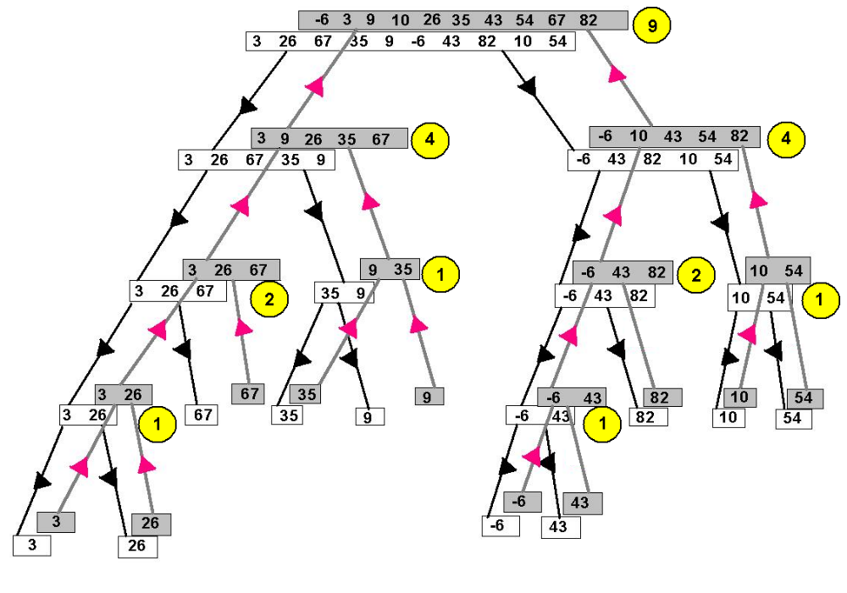

Slide 53
Analysis of Mergesort
链式结构下的归并排序
速度最快的算法之一，其他链表下的算法难以超越
花较多的时间将表一分为二
顺序表下的归并排序
在空间效率、时间效率和程序复杂度三个因素中进行平衡
归并排序是一种稳定的排序算法。

Slide 54
Quicksort for Contiguous Lists
（顺序表的快速排序）
The main function
  Interface method:
  template <class Record>
  void Sortable_list<Record> :: quick_sort( )
  /* Post: The entries of the Sortable-list have been rearranged so that their keys are sorted into non-decreasing order.
  Uses: Contiguous List implementation of Chapter 6, recursive quick sort .*/
  {
  recursive_quick_sort(0, count - 1);
  }

Slide 55
Quicksort for Contiguous Lists
The main function
  Recursive function:
  template <class Record>
  void Sortable list<Record> :: recursive_quick_sort(int low, int high)
  /* Pre: low and high are valid positions in the Sortable_list .
  Post: The entries of the Sortable_list have been rearranged so that their keys are sorted into non decreasing order.
  Uses: Contiguous List implementation of Chapter 6, recursive quick sort ,And partition . */
  {
    int pivot_position;
    if (low < high) { // Otherwise, no sorting is needed.
      pivot_position = partition(low, high);
      recursive_quick_sort(low, pivot_position - 1);
      recursive_quick_sort(pivot_position + 1, high);
  }
  }

Slide 56
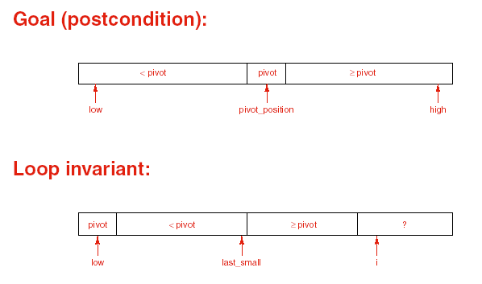
Quicksort for Contiguous Lists
Partitioning the List
  Algorithm Development

Slide 57
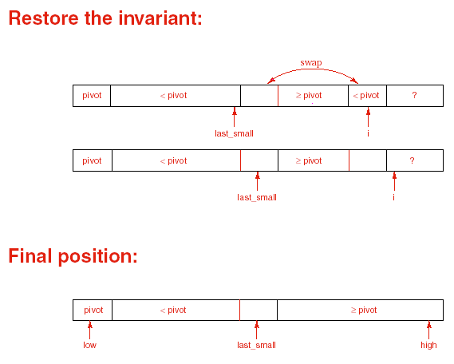
Quicksort for Contiguous Lists
Partitioning the List
  Algorithm Development

Slide 58
Quicksort for Contiguous Lists
Partitioning the List
  template <class Record>
  int Sortable_list<Record> :: partition(int low, int high)
  /* Pre: low and high are valid positions of the Sortable list , with low <= high .
  Post: The center (or left center) entry in the range between indices low and high of the Sortable_list has been chosen as a pivot. All entries of the Sortable_list between indices low and high , inclusive, have been rearranged so that those with keys less than the pivot come before the pivot and the remaining entries come after the pivot. The final position of the pivot is returned.
  Uses: swap(int i, int j) (interchanges entries in positions i and j of a Sortable_list ),the contiguous List implementation of Chapter 6, and methods for the class Record . */
  {Record pivot;
  int i, //used to scan through the list
  last_small; //position of the last key less than pivot

Slide 59
Quicksort for Contiguous Lists
Partitioning the List
  swap(low, (low + high)/2);
  pivot = entry[low]; // First entry is now pivot .
  last_small = low;
  for (i = low + 1; i <= high; i++)
  /* At the beginning of each iteration of this loop, we have the following conditions: If low < j <= last_ small then entry[j].key < pivot .
  If last_small < j < i then entry[j].key >= pivot .*/
  if (entry[i] < pivot) {
    Last_small = last_small + 1;
    swap(last_small, i); // Move large entry to right and small to left.
    }
  swap(low, last_small); // Put the pivot into its proper position.
  return last_small;
  }

Slide 60
（ 80 ，100，85，40 ，75 ，65 ，95，82，10 ，20 ）
（ 80 ，100，100，40 ，75 ，65 ，95，82，10 ，20 ）
  if (entry[i] < pivot) {
    Last_small = last_small + 1;
    swap(last_small, i); // Move large entry to right and small to left.
    }
Notes:
Quicksort is a non-stable sort algorithm.

Slide 61
Analysis of Quicksort
Worst-case analysis
  If the pivot is chosen poorly, one of the partitioned sublists may be empty and the other reduced by only one entry. In this case, quicksort is slower than either insertion sort or selection sort.
Choice of pivot
  First or last entry: Worst case appears for a list already sorted or in reverse order.
  Central entry: Poor cases appear only for unusual orders.
  Random entry: Poor cases are very unlikely to occur.

Slide 62
Analysis of Quicksort
Average-case analysis
  In sorting a list of n entries in random order, quicksort performs:
  Comparisons:
  Assignments:
  P360: comparison with Mergesort algorithm

Slide 63
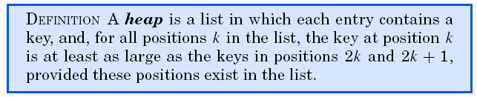
HEAPS AND HEAPSORT
Many C++ manuals and textbooks refer to the area
used for dynamic memory as the “heap”; this use of the word “heap” has nothing to do with the present definition.
Heapsort is suitable only for contiguous lists.

Slide 64
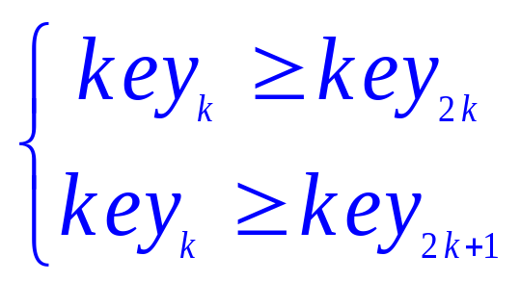
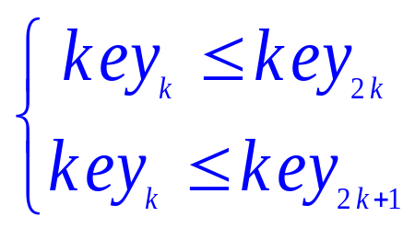
Two kinds of heap
1.The first entry has the largest key
(大顶堆)
2.The first entry has the smallest key
或
(小顶堆)
例如:
{12, 36, 27, 65, 40, 34, 98, 81, 73, 55, 49}
是小顶堆
{12, 36, 27, 65, 40, 14, 98, 81, 73, 55, 49}
不是堆

Slide 65
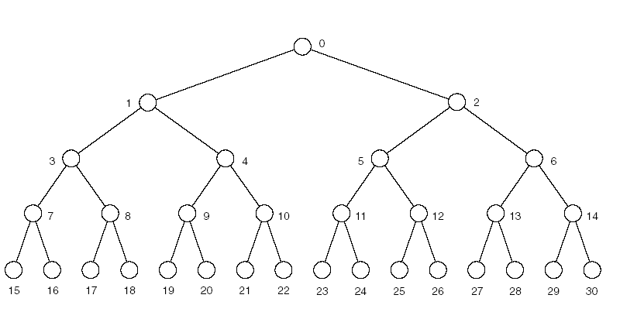
HEAPS AND HEAPSORT
（堆和堆排序）
Complete 2-tree with 31 vertices
If the root of the tree is in position 0 of the list, then the left
and right children of the node in position k are in positions
2k + 1 and 2k +2 of the list, respectively. If these positions
are beyond the end of the list, then these children do not
exist.

Slide 66
we can treat the list as a complete 2-tree
Then key_{2k} is the left child of key_{k} ；
key_{2k+1} is the right child of key_{k} 。
key_{k}
key_{2k}
key_{2k+1}
{12, 36, 27, 65, 40, 34, 98, 81, 73, 55, 49}
例如:
12
36
27
65
40
34
14
98
Isn’t a heap
81
73
55
49
Is a heap

Slide 67
Heap sort proceeds in two phases.
example：rearrange unsorted records
into nondecreasing order
{ 40, 55, 49, 73, 12, 27, 98, 81, 64, 36 }
Build a heap(first is the largest)
{ 98, 81, 49, 73, 36, 27, 40, 55, 64, 12 }
Exchange 98 with 12
{ 12, 81, 49, 73, 36, 27, 40, 55, 64, 98 }
Insert 12 to the heap from 81 to 64
{ 81, 73, 49, 64, 36, 27, 40, 55, 12, 98 }

Slide 68
How to build heap？(build-heap)
How to insert an entry ？(insert-heap)

Slide 69
例如:
12
比较
98
12
81
比较
81
73
49
73
64
36
27
40
55
64
98
12
98
12
Is a heap
After the exchange of 98 and 12,it isn’t a heap now,
We must adjust it .We can think it is a process of inserting 12 to a list which the left and right list is already a heap.

Slide 70
The process of building a heap can be implemented by repeating steps of insert-heap.
Example: the previous order of the list.
40
98
55
81
49
98
49
73
81
73
12
36
36
27
27
98
49
40
81
73
55
64
64
36
12
12
now the left and right list is already a heap，last we insert 98 into the list to satisfy the requirement for a heap.

Slide 71
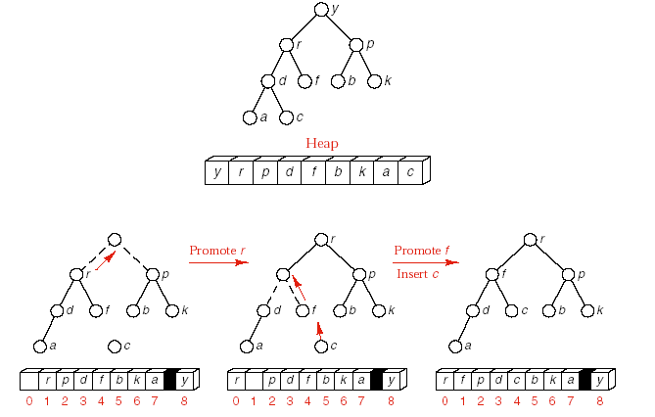
HEAPS AND HEAPSORT

Slide 72
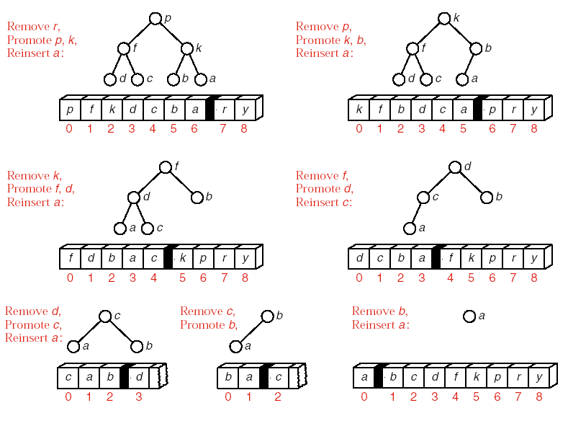
HEAPS AND HEAPSORT

Slide 73
HEAPS AND HEAPSORT
Main function for heapsort
  template <class Record>
  void Sortable_ list<Record> :: heap_ sort( )
  /* Post: The entries of the Sortable_ list have been rearranged so that their keys are sorted into nondecreasing order.
  Uses: The contiguous List implementation of Chapter 6,build heap , and insert heap . */
  {
  Record current; // temporary storage for moving entries
  int last_ unsorted; // Entries beyond last_unsorted have been sorted.
  build_ heap( ); // First phase: Turn the list into a heap.
  for (last_ unsorted = count - 1; last_ unsorted > 0;last_ unsorted--) {
    current = entry[last_unsorted]; // Extract last entry from list.
    entry[last _ unsorted] = entry[0]; // Move top of heap to the end
    Insert_ heap(current, 0, last _unsorted - 1); // Restore the heap
  }
  }

Slide 74
HEAPS AND HEAPSORT
Insertion into a heap
  template <class Record>
  void Sortable_ list<Record> ::
  insert_ heap(const Record &current, int low, int high)
  /* Pre: The entries of the Sortable_list between indices low + 1 and high ,inclusive, form a heap. The entry in position low will be discarded.
  Post: The entry current has been inserted into the Sortable_list and the entries rearranged so that the entries between indices low and high ,inclusive, form a heap.
  Uses: The class Record , and the contiguous List implementation of Chapter 6.
  */
  {
  int large; // position of child of entry[low] with the larger key
  large = 2 * low + 1; // large is now the left child of low.

Slide 75
HEAPS AND HEAPSORT
Insertion into a heap
  while (large <= high) {
  if (large < high && entry[large] < entry[large +1])
  Large++; // large is now the child of low with the largest key.
  if (current >= entry[large])
  break; // current belongs in position low.
  else { // Promote entry[large] and move down the tree.
  entry[low] = entry[large];
  low = large;
  large = 2 * low +1;
  }
  }
  entry[low] = current;
  }

Slide 76

Current=12
81
55
81
49
98
73
49
64
27
73
81
73
12
36
36
27
98
49
40
81
73
55
64
64
36
12
98
  while (large <= high) {
  if (large < high && entry[large] < entry[large +1])
  Large++;
  if (current >= entry[large])
  break;
  else {
  entry[low] = entry[large];
  low = large;
  large = 2 * low +1;
  }
  }
  entry[low] = current;
  }

Slide 77
HEAPS AND HEAPSORT
Building the initial heap
  template <class Record>
  void Sortable_ list<Record> :: build_ heap( )
  /* Post: The entries of the Sortable_list have been rearranged so that it becomes a heap.
  Uses: The contiguousList implementation of Chapter 6, and insert heap . */
  {
  int low; //All entries beyond the position low form a heap.
  for (low = count/2 - 1; low >= 0; low--) {
    Record current = entry[low];
    insert_ heap(current, low, count - 1);
  }
  }

Slide 78
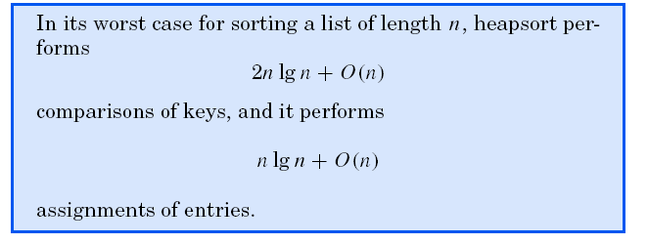
HEAPS AND HEAPSORT
Analysis of Heapsort

Slide 79
稳定性分析
Eg. (36, 27, 3, 27)

Slide 80
补充习题
1、设待排序数据的关键字为（3 26 67 35 9 -6 43 82 10 54）以第一元素为枢轴元素进行快速排序（按关键字值递增顺序），画出一趟排序过程的示意图，并给出一趟分割后的结果。
2、仿照下页对（3 26 67 35 9 -6 43 82 10 54）序列进行归并排序的递归树，画出对序列（512,275,908,677,503,765,612,897,170 ）
进行归并排序的递归树，并计算出总的比较次数。

Slide 82
判断以下序列是否是大顶堆? 如果不是, 将它调整为大顶堆。
(1) { 100, 86, 48, 73, 35, 39, 42, 57, 66, 21 }
(2) { 12, 70, 33, 65, 24, 56, 48, 92, 86, 33 }

Slide 83
HEAPS AND HEAPSORT
Priority Queues
  DEFINITION： A priority queue consists of entries, such that each entry contains a key called the priority of the entry. A priority queue has only two operations other than the usual creation, clearing, size, full, and empty operations:
    Insert an entry.
    Remove the entry having the largest (or smallest) key.
  If entries have equal keys, then any entry with the largest key may be removed first.

Slide 84
Comparison of Sorting Methods
Use of space
Use of computer time
Programming effort
Statistical analysis
Empirical testing

Slide 85
Pointers and Pitfalls
1. Many computer systems have a general-purpose sorting utility.
2. In choosing a sorting method, take into account the ways in which the keys will usually be arranged before sorting, the size of the application, the amount of time available for programming,the need to save computer time and space, the way in which the data structures are implemented, the cost of moving data, and the cost of comparing keys.

Slide 86
3. Divide-and-conquer is one of the most widely applicable and most powerful methods for designing algorithms. method and program it using recursion.
4. Mergesort, quicksort, and heapsort are powerful sorting methods, more difficult to program than the simpler methods, but much more efficient when applied to large lists.
5. Priority queues are important for many applications. Heaps provide an excellent implementation of priority queues.

Slide 87
Exercise and project
采用顺序存储结构，实现插入排序，归并排序，快速排序，堆排序，并对这些算法的实现效率进行比较和分析。

